Slide 1

Graphing Parabolas in Vertex Form
Basically the same thing
as graphing Absolute Value

Slide 2
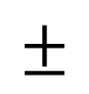
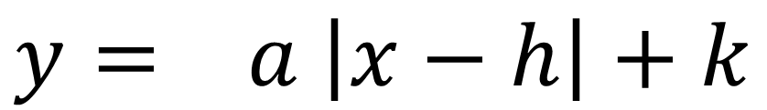
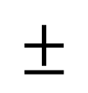
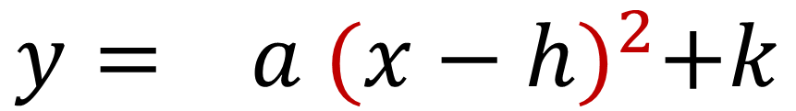
Absolute Value
equation.
Vertex Form
of a parabola.
$$y= a \left|x−h\right|+k$$
$$y= a {(x−h)}^{2}+k$$
$$±$$
$$±$$
slope
stretch
shift left / right
shift left / right
shift up / down
shift up / down
opens up / down
opens up / down

Slide 3

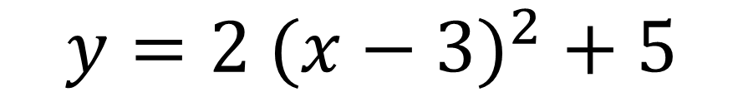


Absolute Value
equation.
Vertex Form
of a parabola.
+
3
5
+
3
5
$$y=2 {(x−3)}^{2} + 5$$
$$y=2 \left|x−3\right|+5$$
$$2$$
$$2/1$$
V
U
Shape: ______
Opens: _________
Vertex: ____________
Slope: _______
Shape: ______
Opens: _________
Vertex: ____________
Over 1, up ______
X’s lie!
X’s lie!
up
up
( , )
( , )

Slide 4
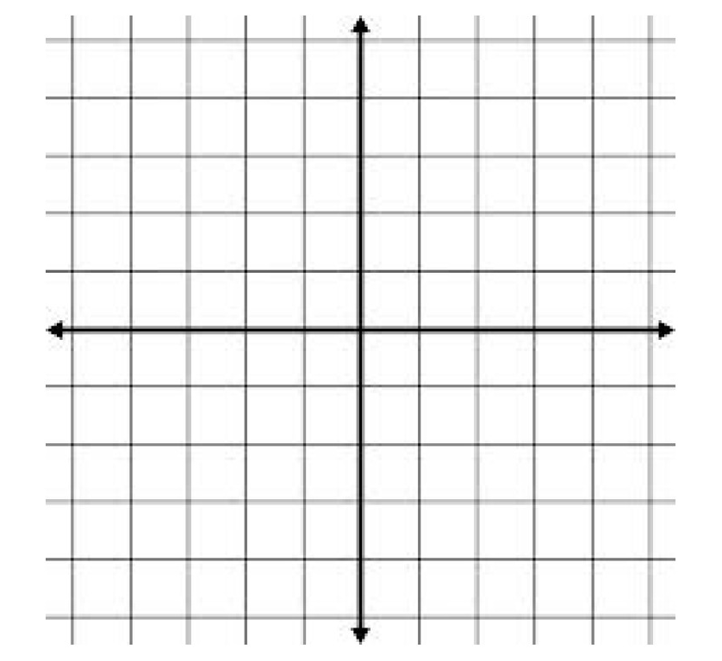


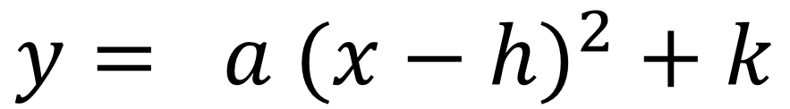
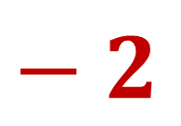

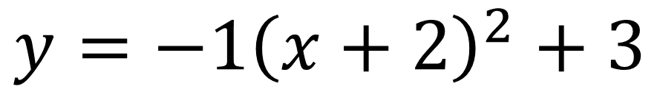
$$y= a {(x−h)}^{2} + k$$
$$±$$
$$1$$
$− 2$
$$3$$
$$y=−1{\left(x+2\right)}^{2}+3$$
X’s lie!
( , )
Vertex: ____________
Opens: __________
Over 1, _______ ____
down
down
direction
number

Slide 5



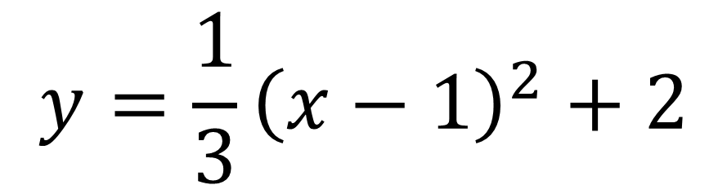
$$y= a {(x−h)}^{2} + k$$
$$±$$
$$\frac{1}{3}$$
$$y=\frac{1}{3}{\left(x−1\right)}^{2}+2$$
$1$
$$2$$
X’s lie!
( , )
Vertex: ____________
Opens: __________
Over 1, _______ ____
up
up
direction
number

Slide 6



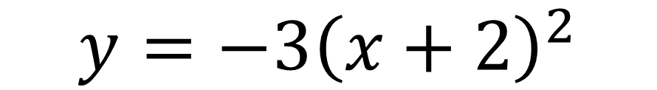
$$y= a {(x−h)}^{2} + k$$
$$±$$
$$3$$
$− 2$
$$0$$
$$y=−3{\left(x+2\right)}^{2}$$
X’s lie!
( , )
Vertex: ____________
Opens: __________
Over 1, _______ ____
down
down
direction
number

