Slide 1
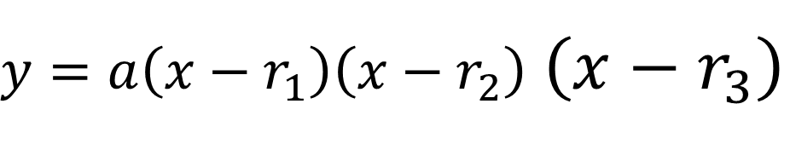
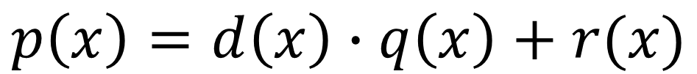
Polynomials:
Dividing, Roots, and Factors
Long Division
Divide small
Multiply
Subtract
Bring Down
X’s lie!
-3
2 7 5 5 8
-6 -3 -6 3
$y=a\left(x−r_{1}\right)\left(x−r_{2}\right)$ $\left(x−r_{3}\right)$
2 1 2 -1 11
$$p\left(x\right)=d\left(x\right)∙q\left(x\right)+r(x)$$

Slide 2
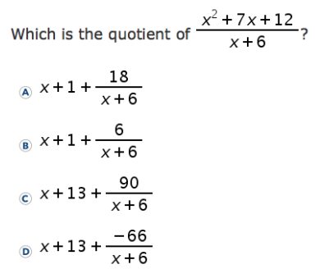
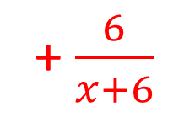
1
-6
1
7
12
-6
-6
1
1
6
+ $\frac{6}{x+6}$
1x
+1

Slide 3
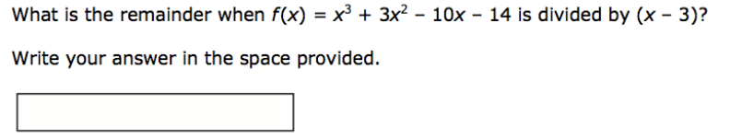
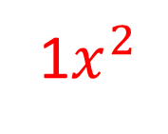
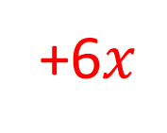
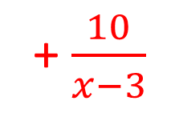
2
10
+3
1
3
-10
-14
3
18
24
1
6
8
10
1$x^{2}$
+6$x$
+8
+ $\frac{10}{x−3}$

Slide 4
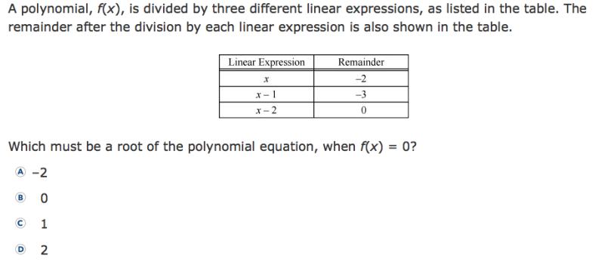
3
X’s lie!

Slide 5
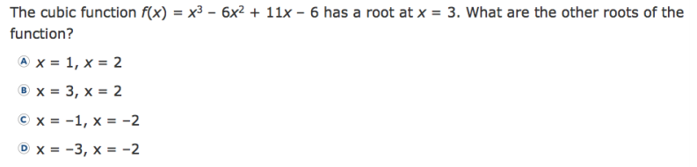



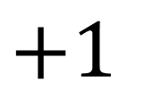

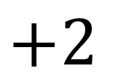

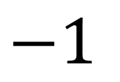

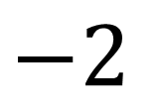
4
+3
1
-6
11
-6
3
-9
6
1
-3
2
0
X’s lie!
$x^{2}$
$−3x$
+ 2
$$−2$$
$$x$$
$$( )$$
$$x$$
$$( )$$
$$−1$$
$$+2$$
$$+1$$

Slide 6
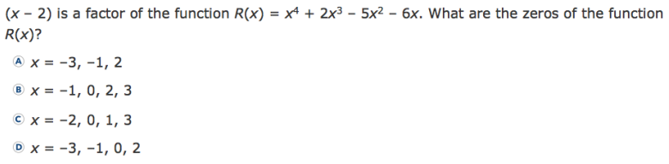
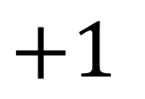


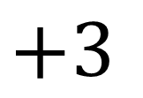

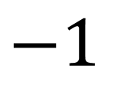
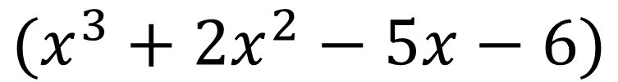
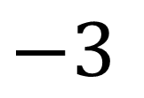
5
$$x$$
$$(x^{3}+2x^{2}−5x−6)$$
$$0$$
+2
1
2
-5
-6
2
8
6
1
4
3
0
X’s lie!
$x^{2}$
$+4x$
+ 3
$$+3$$
$$x$$
$$( )$$
$$x$$
$$( )$$
$$+1$$
$$−3$$
$$−1$$

Slide 7
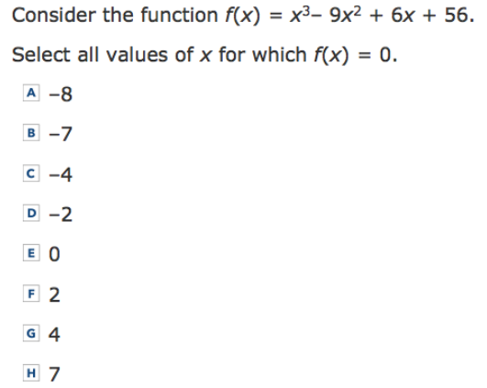

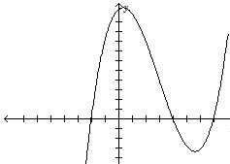
6
If it doesn’t go into 56,
it isn’t a zero!

Slide 8
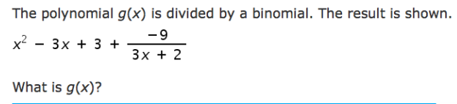
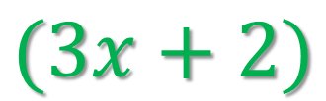
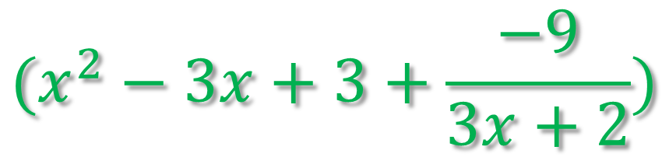
7
What did we divide by?
How do we undo division?
Multiply!
$$(x^{2}−3x+3+\frac{−9}{3x+2})$$
$$(3x+2)$$

Slide 9
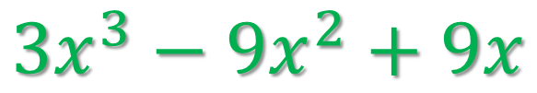

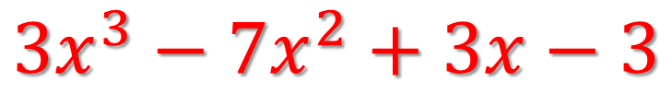
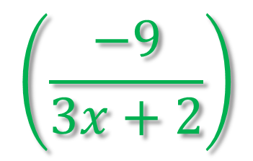
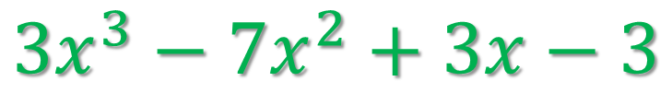
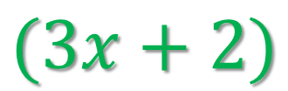
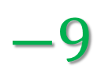
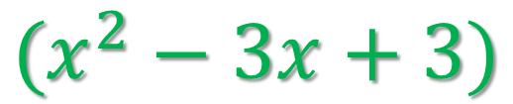
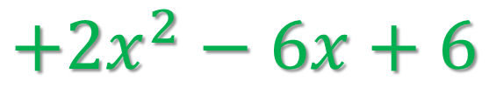
7
What did we divide by?
How do we undo division?
Multiply!
$$3x^{3}−7x^{2}+3x−3$$
$$\left(\frac{−9}{3x+2}\right)$$
$$(3x+2)$$
$$(x^{2}−3x+3)$$
$$+$$
$$(3x+2)$$
$$3x^{3}−9x^{2}+9x$$
$$+2x^{2}−6x+6$$
$$3x^{3}−7x^{2}+3x−3$$
$$−9$$

