Slide 1
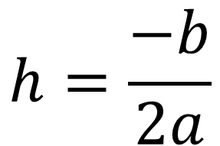
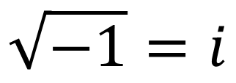
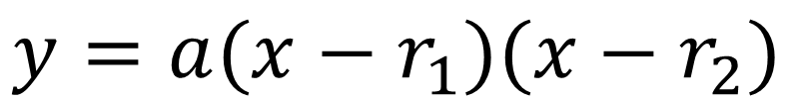
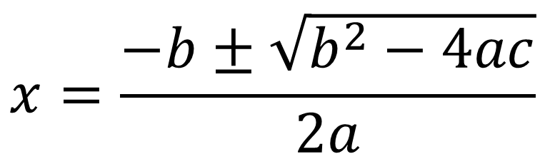
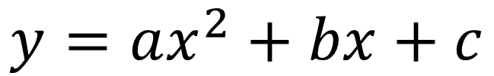
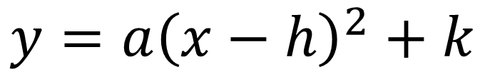
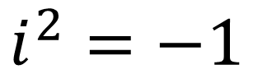
Quadratics EoC Prep
$$x=\frac{−b±\sqrt{b^{2}−4ac}}{2a}$$
$$y=a{\left(x−h\right)}^{2}+k$$
$$y=ax^{2}+bx+c$$
$$\sqrt{−1}=i$$
$$y=a(x−r_{1})(x−r_{2})$$
$$h=\frac{−b}{2a}$$
$$i^{2}=−1$$

Slide 2
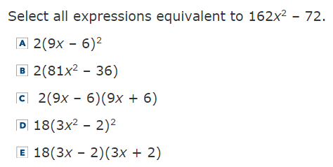

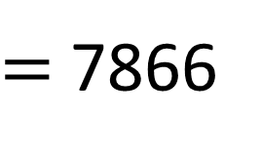
1
$$162{(7)}^{2}−72$$
$=$7866
= 6498
= 7866
= 7866
= 6498
= 7866

Slide 3
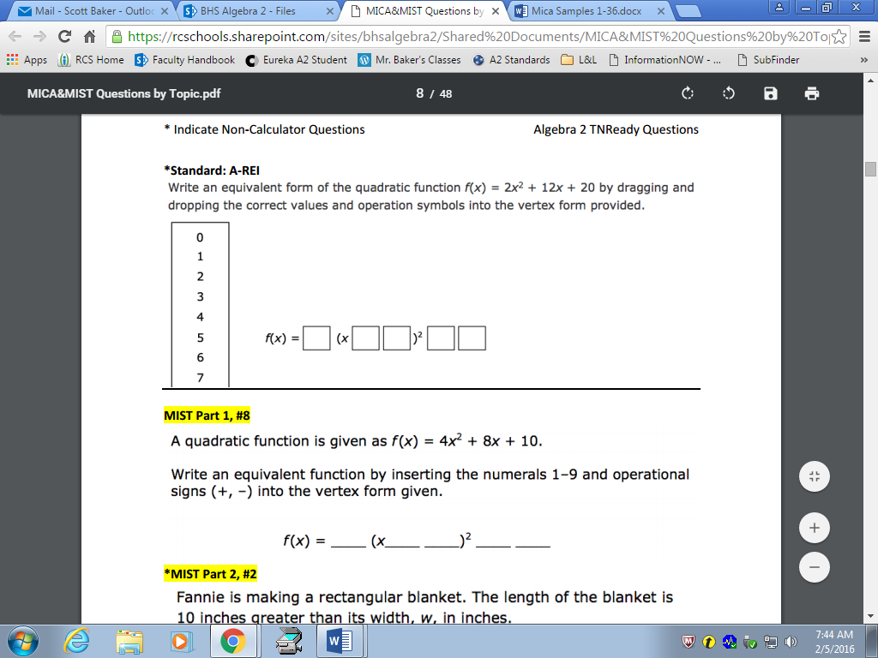

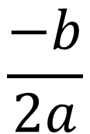




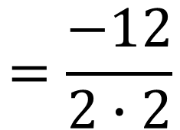

2
$$\frac{−b}{2a}$$
$$=\frac{−12}{2∙2}$$
$$=−3$$
7
8
9
+
̶
$$2{(−3)}^{2}+12\left(−3\right)+20$$
$$=2$$
$$f\left(x\right)=a (x−h)^{2} +k$$
2
$$+ 3$$
$$+ 2$$

Slide 4
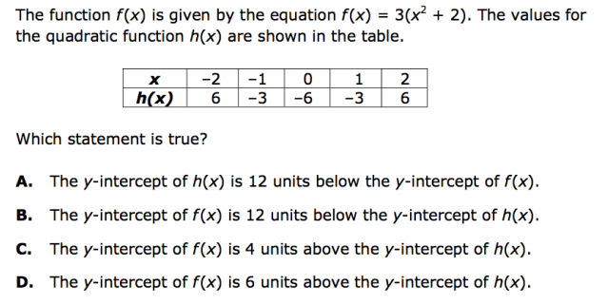



3
$$3(0^{2}+2)$$
$$3(2)$$
$$6$$

Slide 5
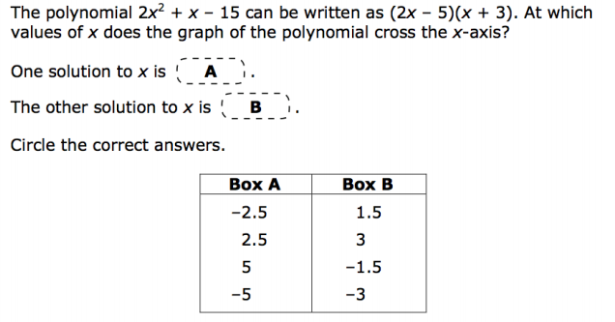
4
EXES LIE!!!!

Slide 6




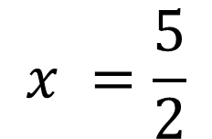
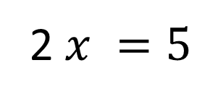
4
$$\left(2x−5\right)=0$$
2 $x =5$
X’s LIE!!!!
$$x =\frac{5}{2}$$
$$=2.5$$
$$\left(x+3\right)=0$$
$$x=−3$$

Slide 7
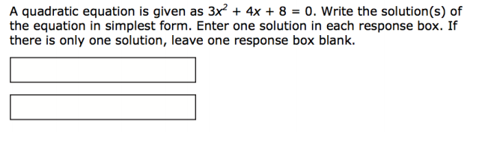
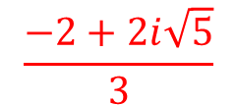
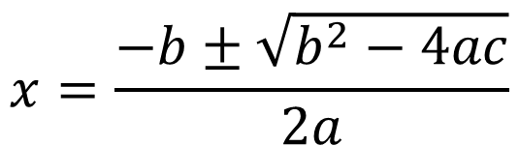
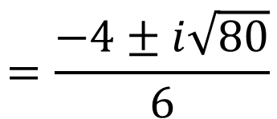
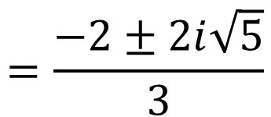
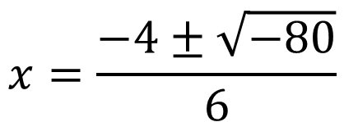
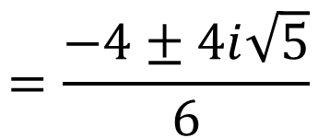
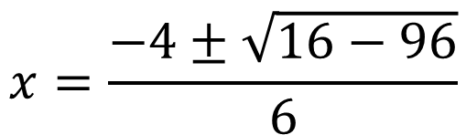

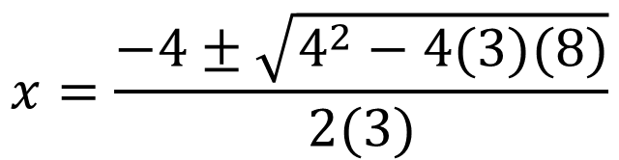

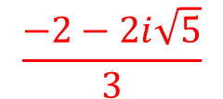
5
$$\frac{−2+2i\sqrt{5}}{3}$$
$$x=\frac{−b±\sqrt{b^{2}−4ac}}{2a}$$
$$\frac{−2−2i\sqrt{5}}{3}$$
$$x=\frac{−4±\sqrt{4^{2}−4(3)(8)}}{2(3)}$$
80
$∙$2
8
10
2
5
$$x=\frac{−4±\sqrt{16−96}}{6}$$
2
5
2
2
2
$$x=\frac{−4±\sqrt{−80}}{6}$$
$$=\frac{−4±i\sqrt{80}}{6}$$
$$=\frac{−4±4i\sqrt{5}}{6}$$
$$=\frac{−2±2i\sqrt{5}}{3}$$

Slide 8
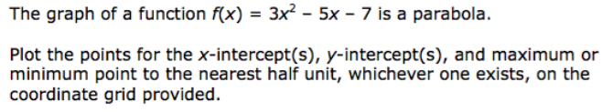
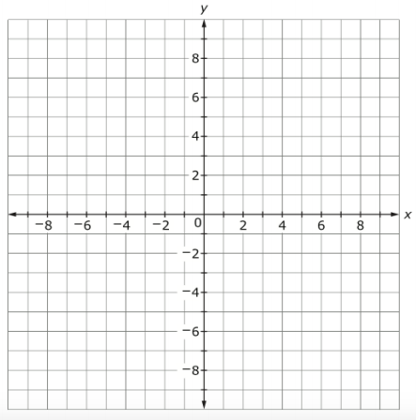
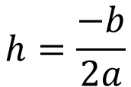



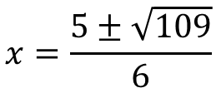

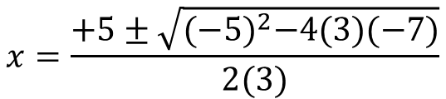
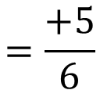
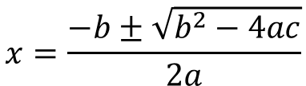
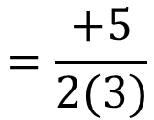
y-intercept
x-intercept
$$x=\frac{−b±\sqrt{b^{2}−4ac}}{2a}$$
$$x=\frac{+5±\sqrt{{(−5)}^{2}−4(3)(−7)}}{2(3)}$$
$$x=\frac{5±\sqrt{109}}{6}$$
$$≈2.57 and −.91$$
$$h=\frac{−b}{2a}$$
$$=\frac{+5}{2(3)}$$
$$=\frac{+5}{6}$$
minimum
$$≈0.83$$
$$k=3{(\frac{5}{6})}^{2}−5\left(\frac{5}{6}\right)−7$$
$$≈−9.08$$

Slide 9






7
A parabola has x-intercepts at 4 and -2 and has a maximum value of 12.
Write the equation of the parabola in any form.
$$−4$$
$$+2$$
$$y=$$
$$a$$
$$(x )$$
$$(x )$$

Slide 10


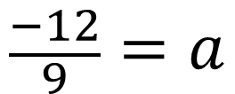
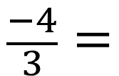







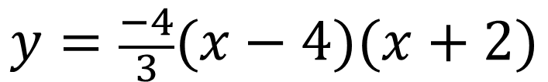


$$12$$
$$4$$
$$-2$$
$$+1$$
7
A parabola has x-intercepts at 4 and -2 and has a maximum value of 12.
Write the equation of the parabola in any form.
$$−4$$
$$+2$$
( , )
OR…
+
?
$$=+1$$
$$y=$$
$$a$$
$$(x )$$
$$(x )$$
$$2$$
$$12=a(+1−4)(+1+2)$$
Find a non-zero point.
y-intercept
vertex
any other ordered pair
$$12=a(−3)(3)$$
$$12=−9a$$
vertex
$$−9$$
$$−9$$
$$\frac{−4}{3}=$$
$$\frac{−12}{9}=a$$
$$y=\frac{−4}{3}(x−4)(x+2)$$

Slide 11
















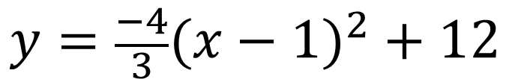






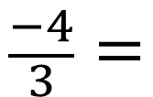




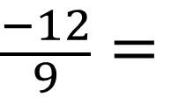
$$4$$
$$1$$
$$+12$$
7
A parabola has x-intercepts at 4 and -2 and has a maximum value of 12.
Write the equation of the parabola in any form.
( , )
( , )
$$0$$
$$1$$
$$12$$
$$a$$
$$(x −h)^{2}+k$$
$$4$$
+
$$-2$$
$$y=$$
$$=+1$$
$$y=$$
$$a$$
$$(x − )^{2}$$
$$2$$
$$0=$$
$$a$$
$$(4−1 )^{2}+12$$
Find a non-zero point.
y-intercept
vertex
any other ordered pair
$$0=$$
$$a$$
$$(3 )^{2}+12$$
$$0=$$
$$a∙$$
$$9+12$$
$$0=$$
$$9a+12$$
any other ordered pair
$$\frac{−4}{3}=$$
$$\frac{−12}{9}=$$
$$a$$
$$y=\frac{−4}{3}(x−1)^{2}+12$$

