Slide 1
Imaginary Numbers Review answers
Station 9
1
2
3
4
5
10
15
20
25
30
Starting in seconds

Slide 2
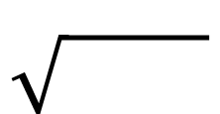

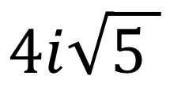
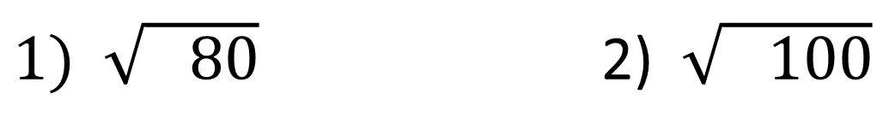

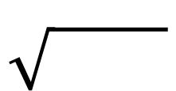
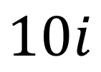


$1) \sqrt{ 80}$ 2) $\sqrt{ 100}$
$$i$$
$$i$$
10
8
4
25
5
2
2
2
2
2
2
5
5
2ּ
2
$$i$$
5ּ
2
$$i$$
$$4i\sqrt{5 }$$
$$10i$$

Slide 3




Combine Like Terms
Combine Like Terms
3) $\left(7−i\right)+\left(5+4i\right)$ 4) $\left(−3+5i\right)−\left(2−4i\right)$
7 + 5
-i + 4i
-3 + -2
5i + 4i
$$12$$
$$+3i$$
$$−5$$
$$+9i$$

Slide 4
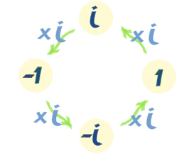

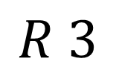
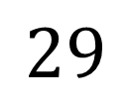
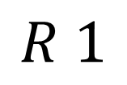
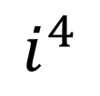

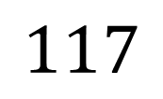
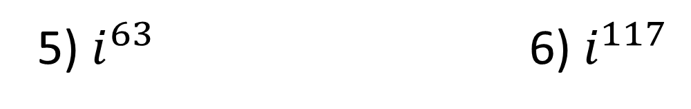


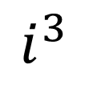
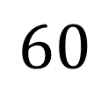
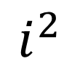
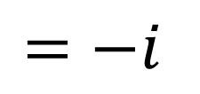
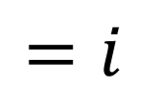
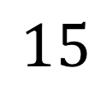
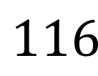
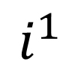
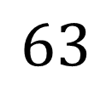
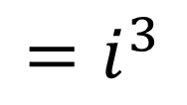
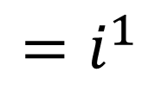
5) $i^{63}$ 6) $i^{117}$
$${=i}^{3}$$
$${=−i}^{ }$$
$${=i}^{1}$$
$${=i}^{ }$$
$$15$$
$$R 3$$
$$29$$
$$R 1$$
$$4$$
$$63$$
$$4$$
$$117$$
$$60$$
$$116$$
$$3$$
$$1$$
$$i^{1}$$
$$i^{2}$$
$$i^{4}$$
$$i^{3}$$

Slide 5
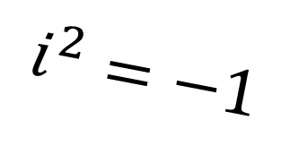














7) $\left(2−3i\right)\left(4+5i\right)$ 8) $\left(−4+3i\right)\left(−4−3i\right)$
$$8$$
$$+10i$$
$$−12i$$
$$−15$$
$$i^{2}$$
$$16$$
$$+12i$$
$$−12i$$
$$−9$$
$$i^{2}$$
$$23$$
$$−2i$$
$$−1$$
$$25$$
$$−1$$
$$i^{2}=−1$$

Slide 6

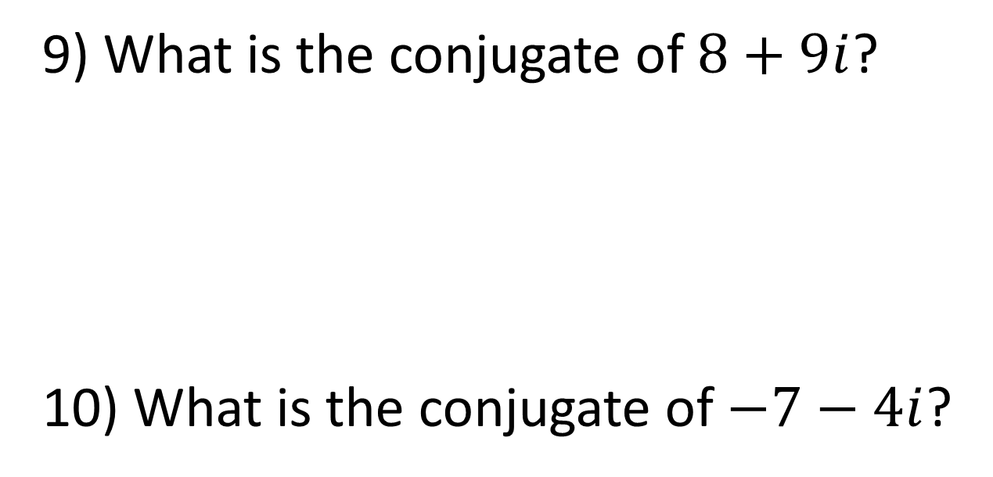



Conjugates: parentheses where everything is the same except the sign in the middle
9) What is the conjugate of $8+9i$?
10) What is the conjugate of $−7−4i$?
$$−$$
$$8+9i$$
$$+$$
$$−7−4i$$

Slide 7
That’s it. Now you’re ready for the quiz.
If you need more help, be sure to check the video links through the calendar on my website.
http://tinyurl.com/BakerBHS

